Slide 1
Award of Excellence in Financial Management

Slide 2
Presenters
Jennifer Land
Chief Financial Officer
Belton ISD
jennifer.land@bisd.net
Byron Bryant
Chief Financial Officer
Royse City ISD
byron.bryant@rcisd.org
Chris Smith
Chief Financial Officer
Katy ISD
christopherjsmith@katyisd.org
Jorgannie Carter
Chief Financial Officer
Pearland ISD
carterj@pearlandisd.org
Shay Adams
Chief Financial Officer
Lovejoy ISD
shay_adams@lovejoyisd.net

Slide 3
Background
Created in 2020
Intended to Recognize Districts for Outstanding Financial Management and Transparency Practices
Includes Eleven Distinct Subcategories
Notes:
Jennifer to give background of the program – why it was created, last year was the first year, 10 districts awarded

Slide 4
Notes:
Everyone to talk about why they submitted – This is the list of words I used for word cloud. Then discuss how in a perfect world you would gather during budget / annual audit.
Pioneering
Trust
Confidence
Analytics
Best Practice
Dependable
Good
Compliance
Reliable
Consistent
Trust
Check
Controls
Documentation
Transparent
Innovative
Training
Required
Understanding
Innovation
Illuminate
Proud
Showcase
Detail
Verify
State-of-the-art
Consistent
Trustworthy
Insight
Awareness
Transparency
Ability
Discernment
Educational
Focused
Authenticate
Support

Slide 5
Section 1: Required Category
Organizational Chart
Job Descriptions
Financial Transparency
5-years of Budgets
Budget and Tax Rate Hearing Documents
FIRST Ratings
Unqualified Audit Opinion
Debt Transparency Report
Proof of Bank Reconciliations
Notes:
The financial transparency is a hot link to Lovejoy Financial Transparency webpages. Score is based on the least number of clicks from the home page and what is there – Shay to discuss
Proof of Bank Reconciliations – Jennifer to discuss

Slide 6
Section 2: Financial/Business Department
Publications of Required Notices
Management Letter
Findings and Questioned Costs
Best Practice Metrics
Internal Audit
Procedures Documentation
Self-funded Health Insurance
Procurement
Notes:
Internal Audit – Jennifer to discuss about an audit plan and proof of execution.

Slide 7
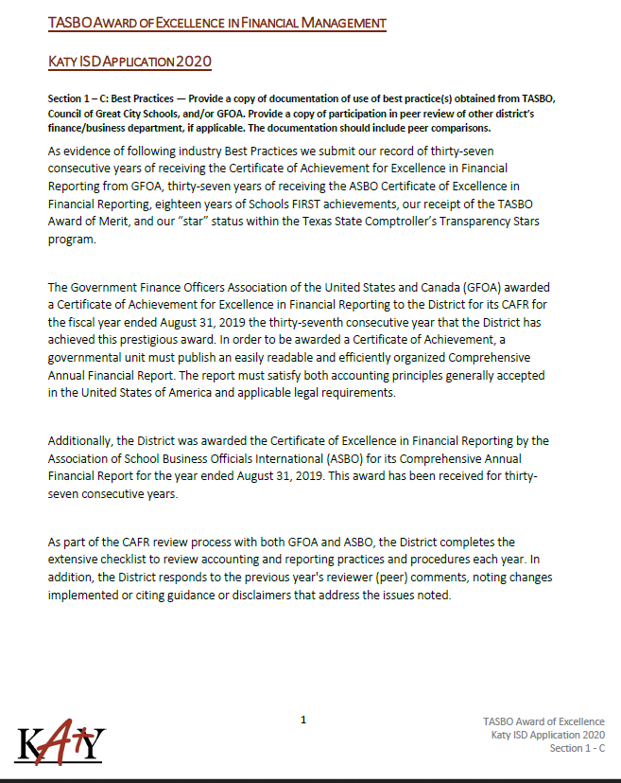
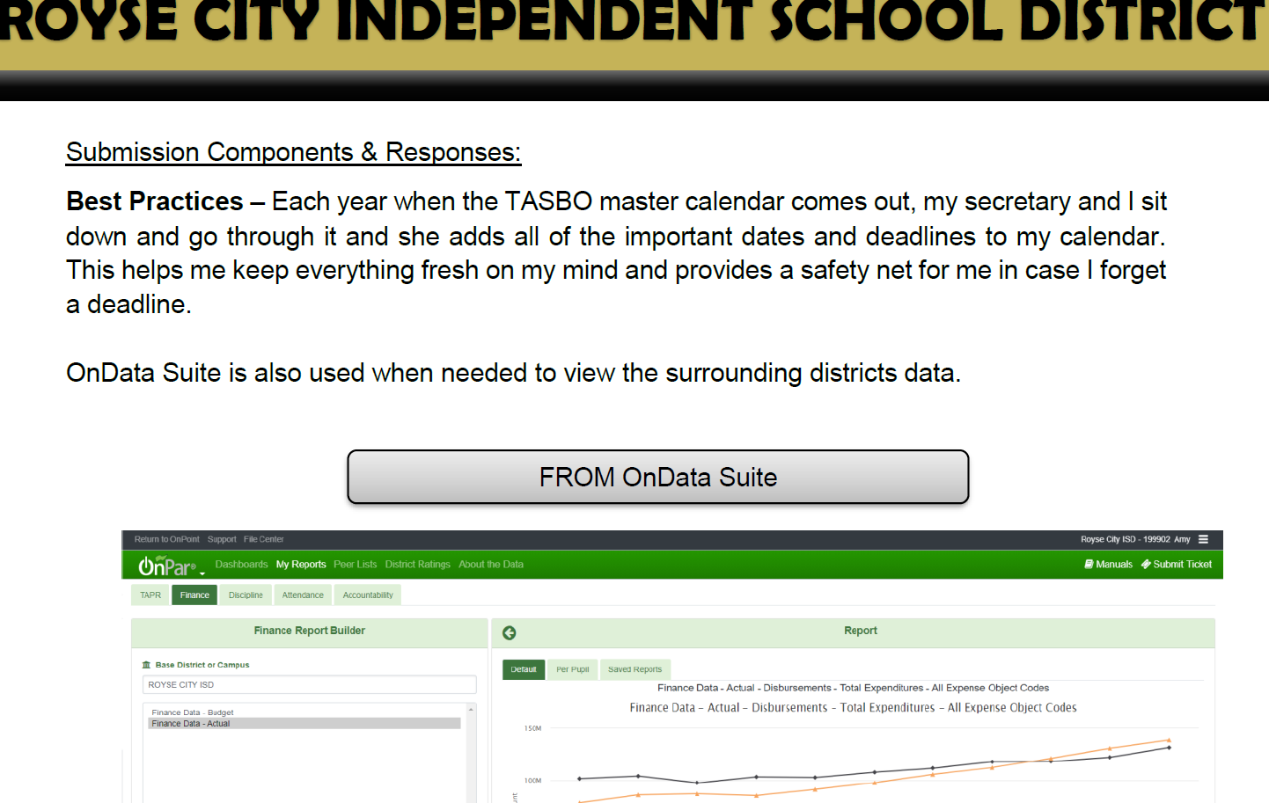
Notes:
Chris and Byron to talk about use of Analytical Tools and incorporation into budget process. Just general overview of use of metrics.

Slide 8
Section 3: Financial/Business Department Staffing
Education Level
TASBO Certification
Professional Certification
Staff Training
Internal Control Training for Staff

Slide 9
Section 4: Staffing Controls
Staffing Guidelines
Performance Metrics
Staffing Budget
Notes:
Chris – please discuss mobility, transfer type reports you use in staffing projections

Slide 10
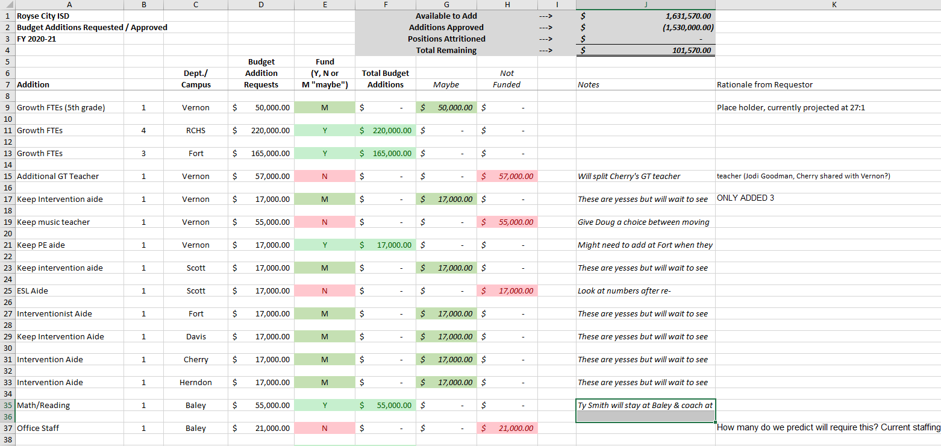
Notes:
Byron, Please describe your worksheet

Slide 11
Section 5: Budget Management
Budget Development Calendar
Budget Development Decisions
Budget Presentation
School FIRST
Ease of Understanding
Replacement Cycles
Fund Balance
Debt Service
Analysis of Appraised Values
Expense Reimbursement
Notes:
Jennifer to give an overview of this section – everyone will speak to their slides below

Slide 13
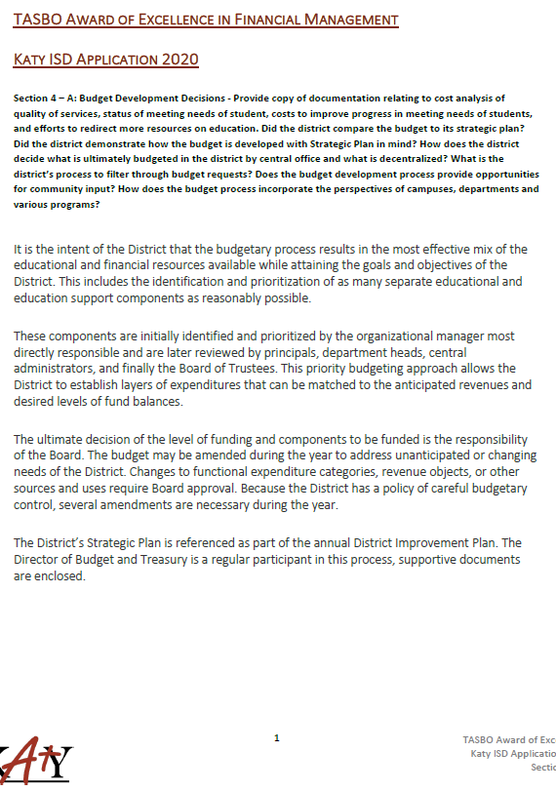
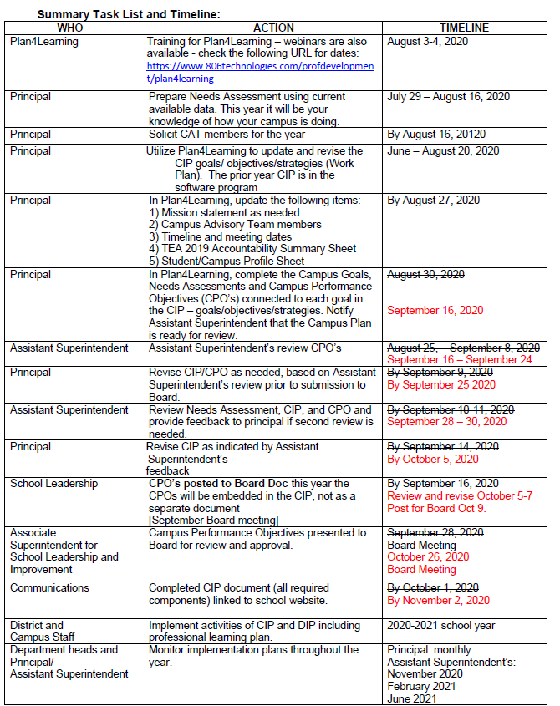
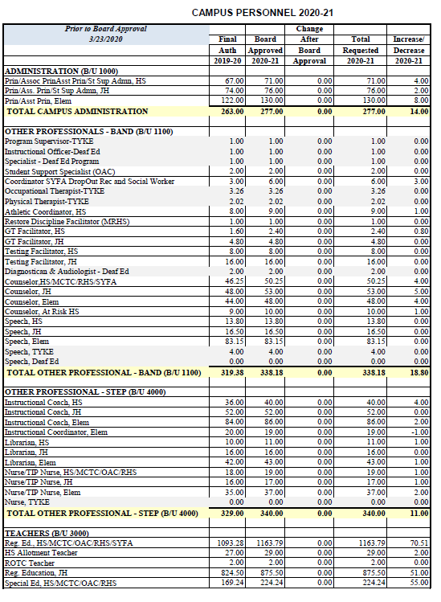

Slide 14
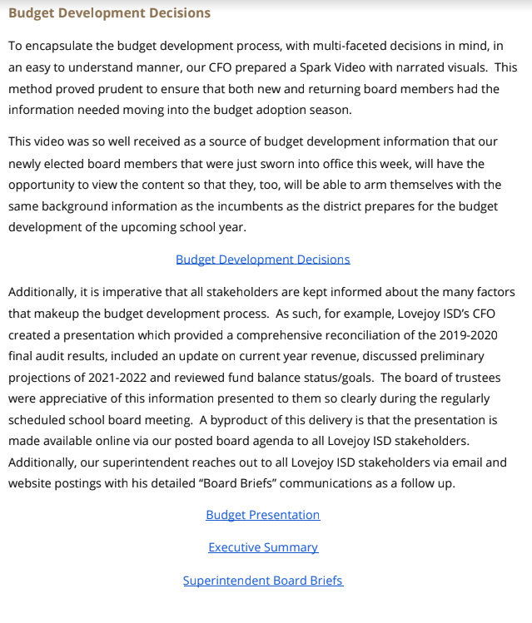
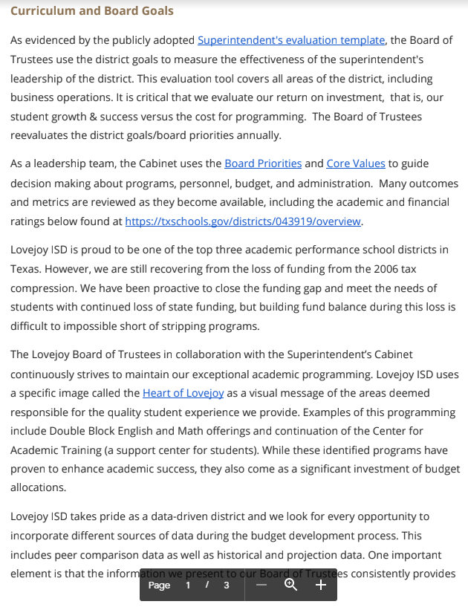

Slide 17
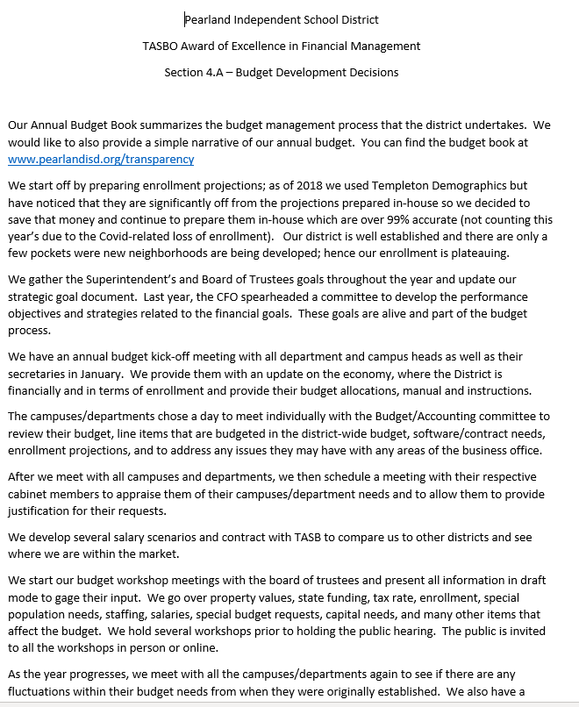
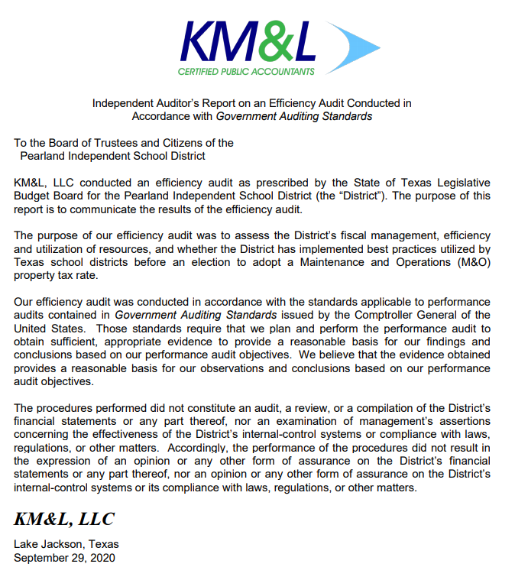
Notes:
Jorgannie,
I like that you had an efficiency audit. Can you explain a bit about how you used it?

Slide 18
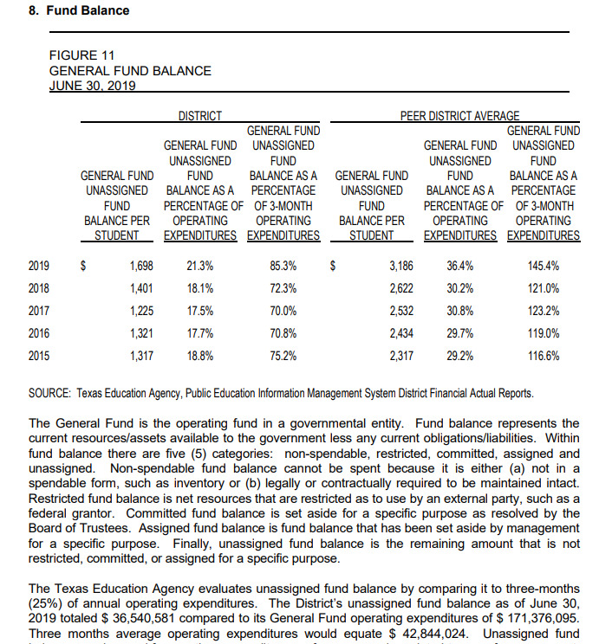
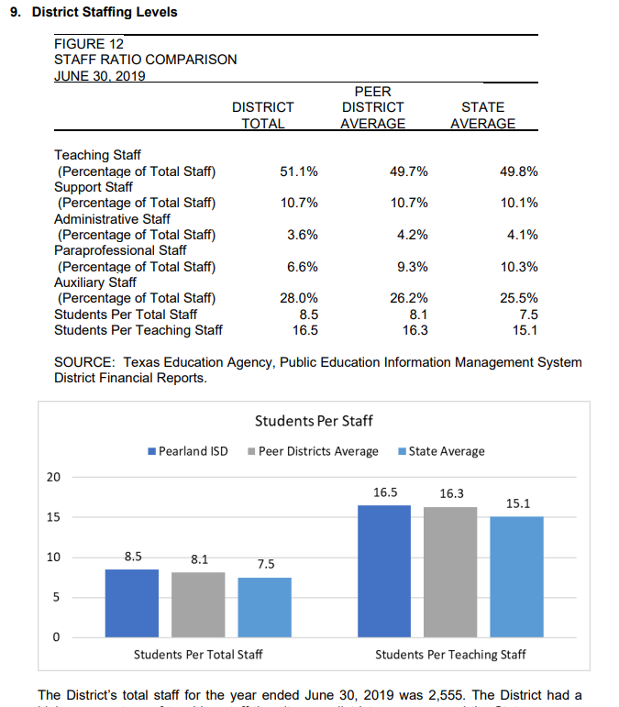

Slide 19
Section 6: Financial Management Process
Revenue Monitoring
Financial Accounting Processes
Salary Accrual
Federal Programs
Cross Training of Personnel
Communications with Stakeholder Groups
Facility Use
Procurement Cards
Notes:
Shay to explain revenue monitoring / stakeholder groups

Slide 20
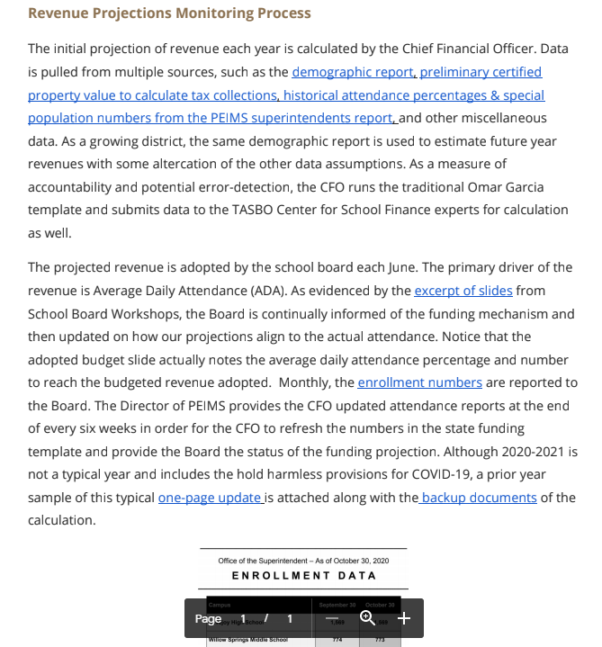

Slide 21
Section 7: Cash Management
Investments
Collateralization
Cash Flow Analysis
Decentralized Campus Activity Funds
Collection and Disbursement of Funds
Internal Control Training
Notes:
Jorgianne to focus on cash flow next slide

Slide 22
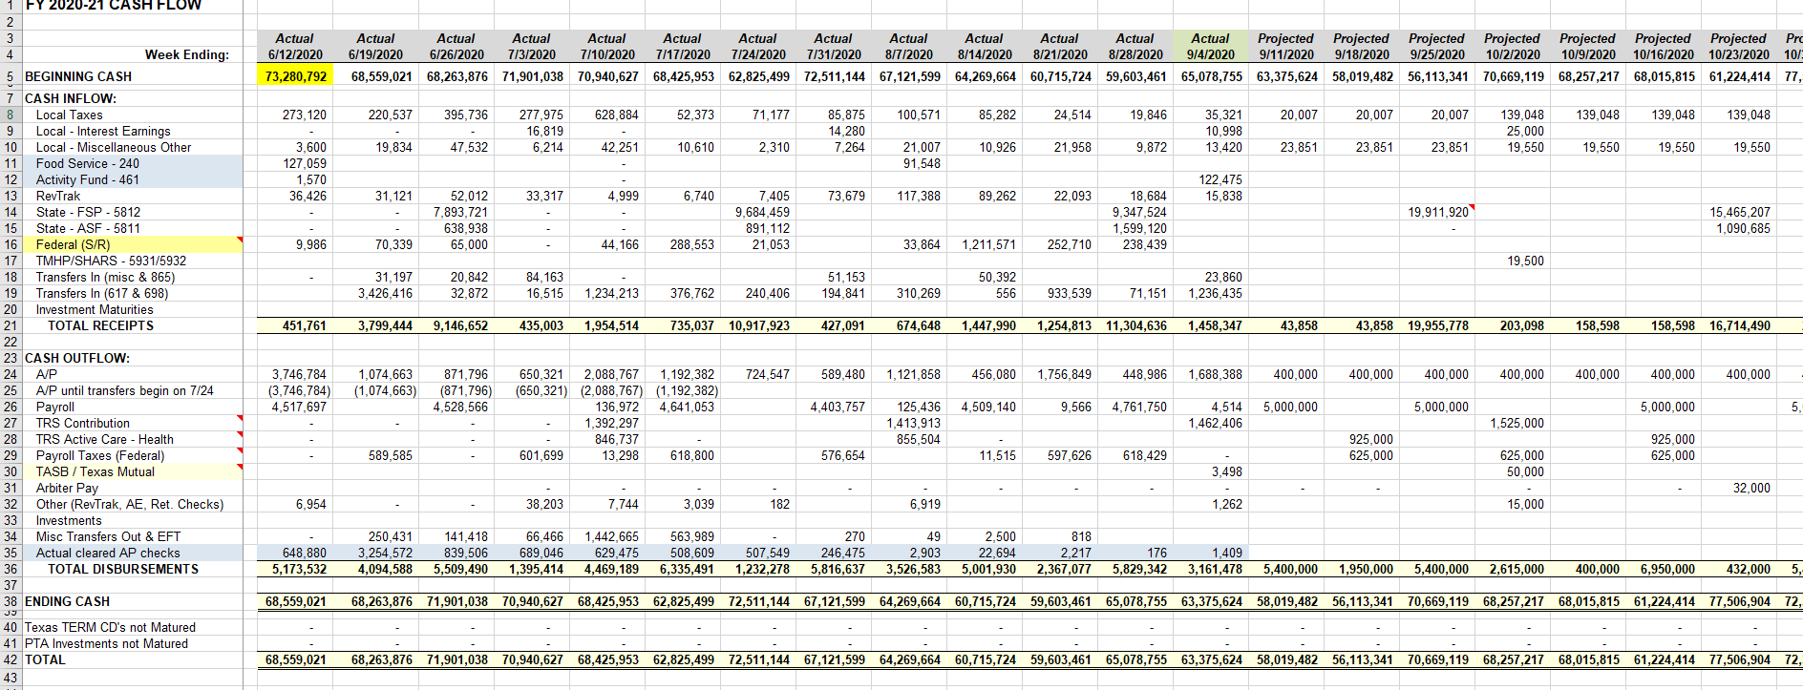

Slide 23
Section 8: Communications
Financial Reporting
Availability of Information
Internet Posting Requirements
External Staff Training
Notes:
General Discussion – talk about external staff training, list on TASBO website – Internet posting will be hot link

Slide 24
Section 9: Financial Reports
Annual Financial Reports
Interim Financial Reports
Notes:
Jorgianne

Slide 25
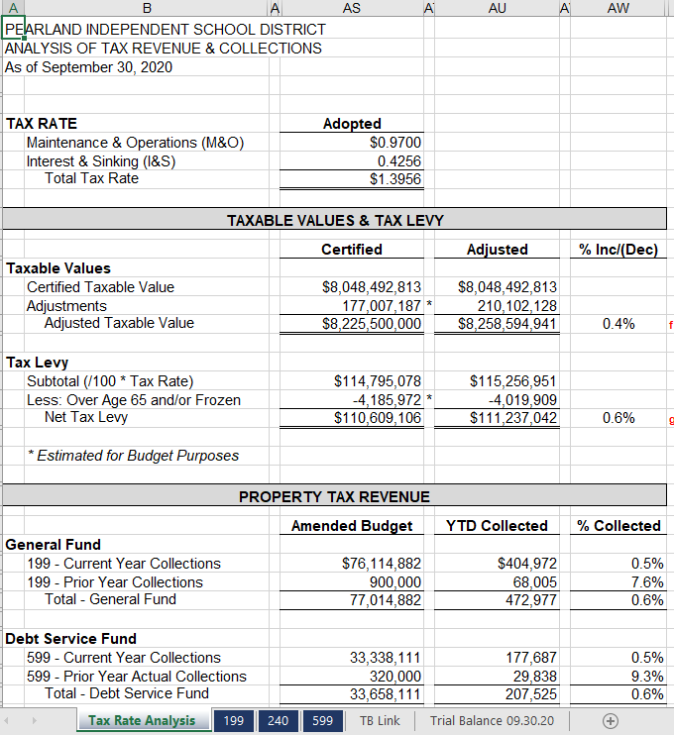
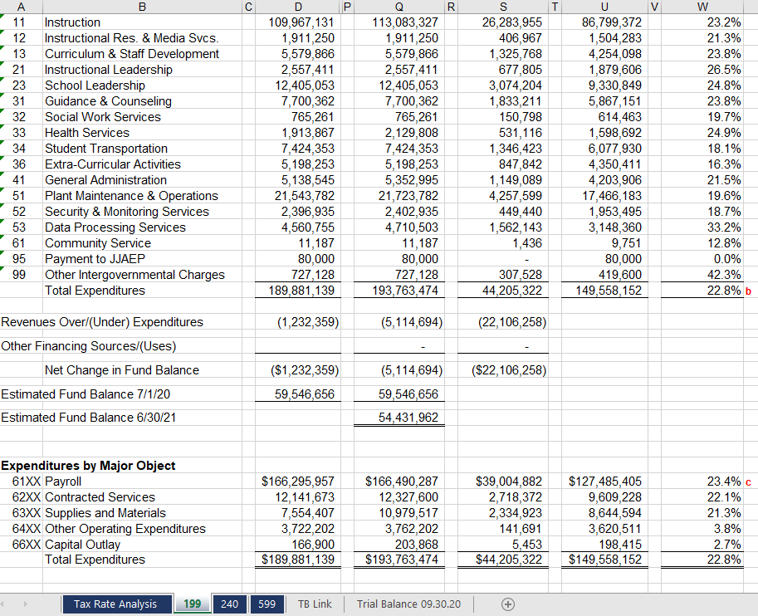

Slide 26
Section 10: Financial Analyses and Projections
Enrollment and ADA Trend
Property Value Trend
Expenditures per Student
Instructional Staff per Student
Total Staff per Student
Total Operating Revenue per Student
Fund Balance as Percent of Operating Expenditures
Fiscal Projections
Notes:
Chris to share some examples

Slide 27
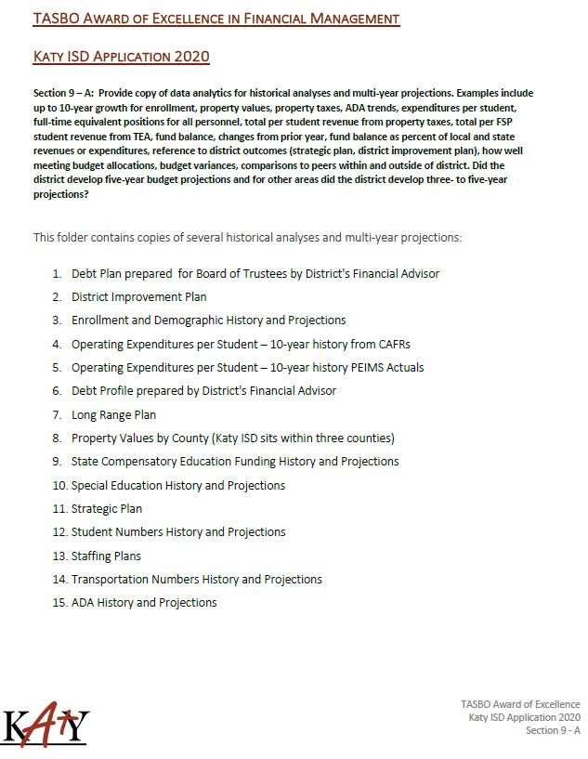
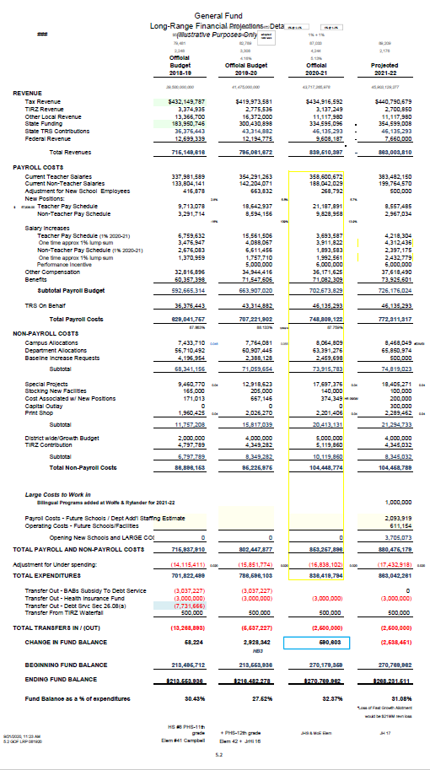

Slide 28
Section 11: Innovation Bonus Points
Management Review
Efficiency and Economy
Student Achievement
Communications
Processes
Technology
Strategic Plan
Notes:
Chris to share some examples

Slide 29
Process to Submit
Pearland ISD Basecamp

Slide 30
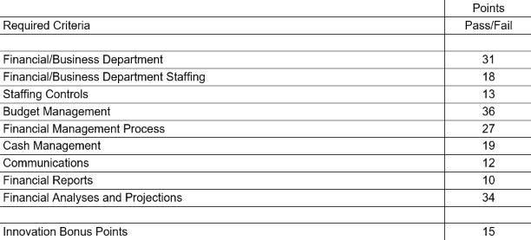
Qualifications / Due Dates
Applications due by November 1st
Minimum Point Total of 150* out of possible 200 points
* Districts with enrollments less than 5,000 students required to attain a minimum of 120 points

Slide 31
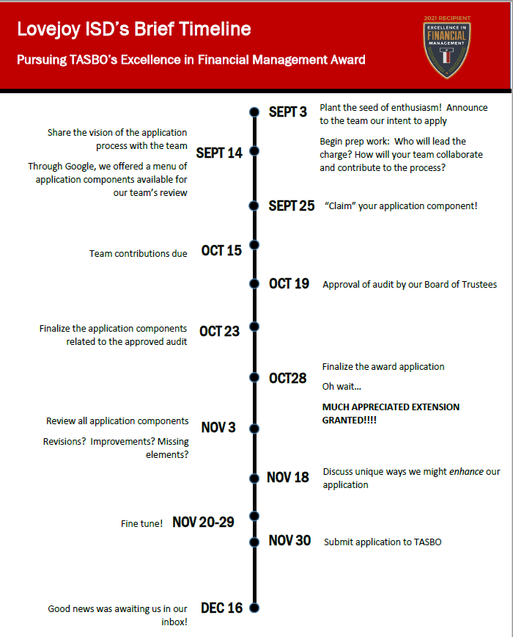

Slide 32
Please Submit Questions During Application to…
Tracy Ginsburg
Executive Director
tginsburg@tasbo.org
512.617.0068

